Slide 1
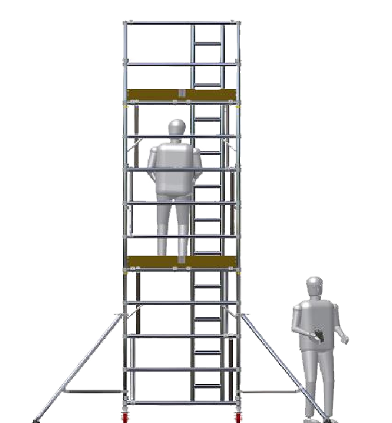
Working at height with towers: which bits are you missing?
Notes:
Welcome
Introductions
Thanks to host
This is your day

Slide 2
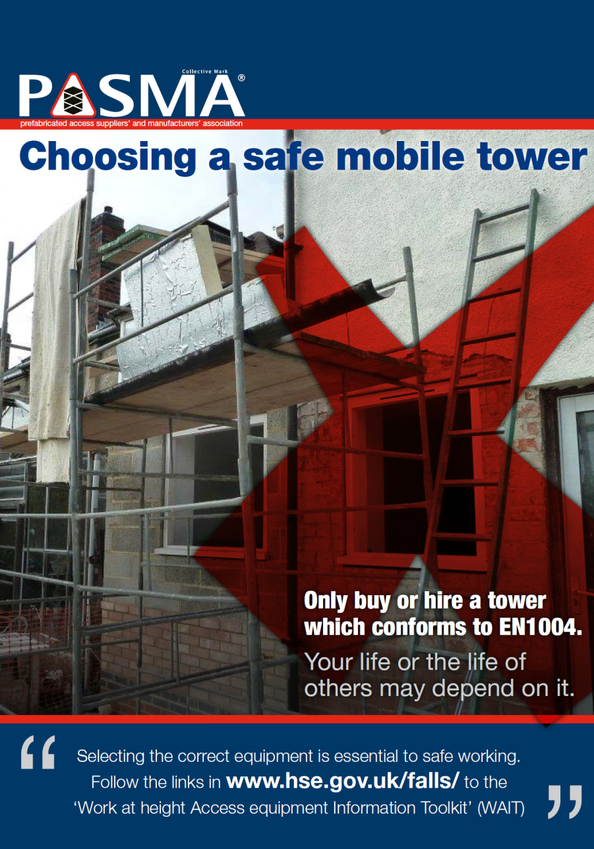
Which bits are you missing?
  Selection
  Build
  Inspection
  Competence

Slide 3
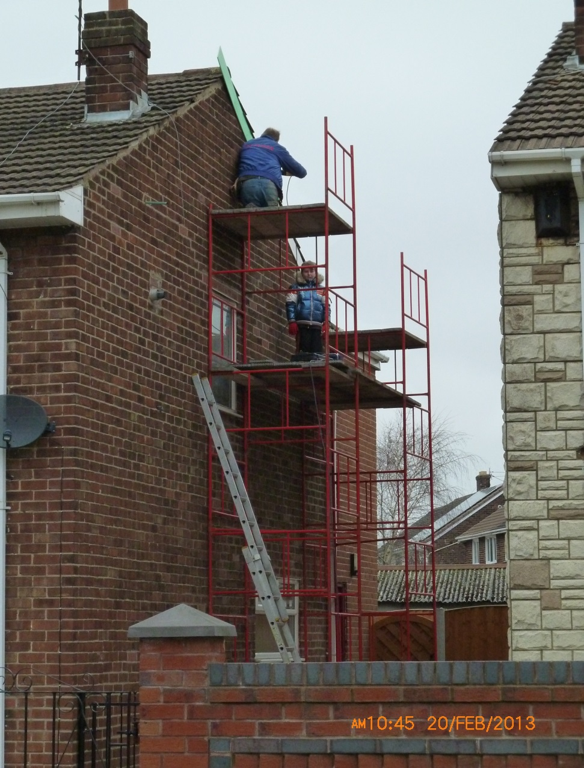
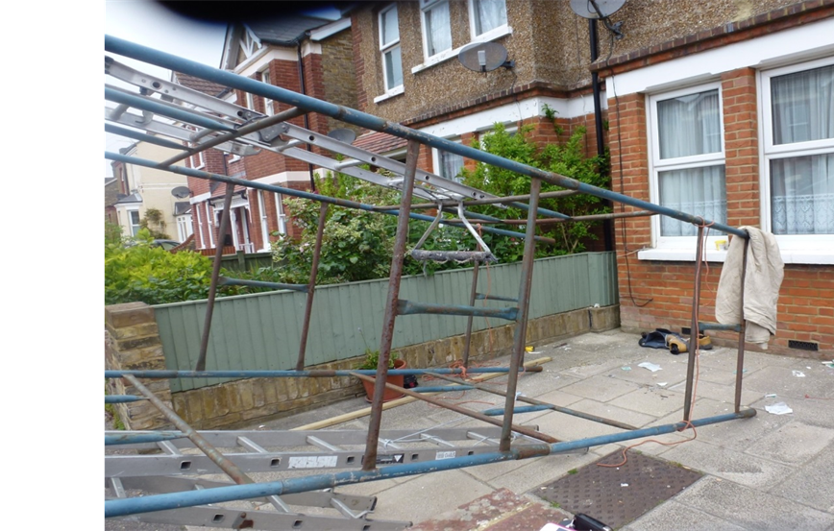
Which bits are you missing?
Notes:
Examples of H frame steel towers in use
The one on the left resulted in an HSE prosecution
Self Employed Builder using H Frame tower.
No safe means of access and egress. Using portable ladder.
No safe platform. Using boards laid between the two towers. No toe boards
No guardrails
No stabilisers
No safe method of build and dismantle
The other person on the tower is his young son
Example on the right of H Frame steel tower. Used by small building firm.
H Frame tower that overturned
No safe means of access. They had tied a roof ladder to the side.
No stabilisers. Not tied in.
Obvious slope to drive. No adjustable legs so tower was not level
No platforms
No base plates
No safe method of build and dismantle
Persons seriously injured falling from tower.
Tower fell onto vehicle parked on roadside. Luckily no persons walking along pavement at the time of the incident

Slide 4
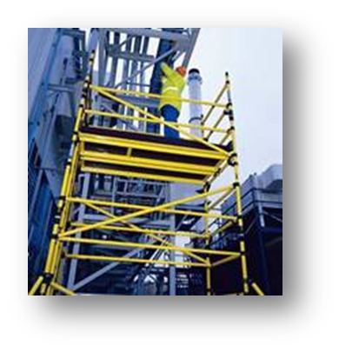
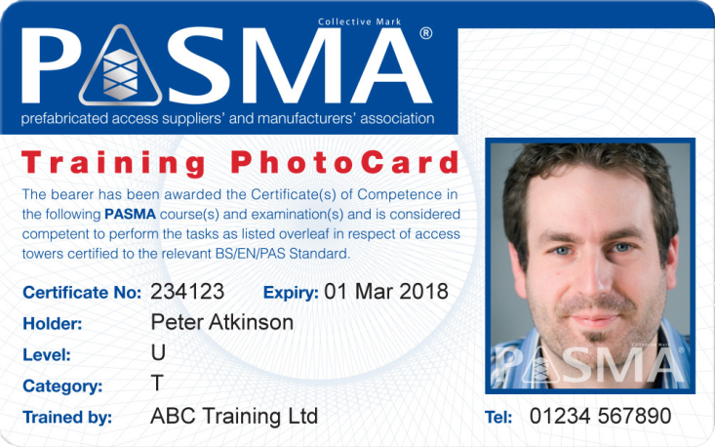
About PASMA
  The Prefabricated Access Suppliers and Manufacturers Association
  Formed in 1974
  Represents the mobile access tower industry in the UK
  Is the recognised training provider and authority for mobile access towers
  Working with the regulatory authorities and standards setting bodies
Notes:
PASMA is the UK industry body for Mobile Access Towers and the recognised authority on this type of access equipment and the provider of training and verification of competence.
More than 400 PASMA approved training centres throughout the UK deliver the PASMA training syllabus.
Founder member of the Access Industry Forum
Working with the HSE, BSI, IOSH, ROSPA, APS
PASMA deliver information and competence in mobile towers to thousands of people every year
60,000 people trained this year so far
The PASMA Certificate of Competence and PhotoCard, is a nationally recognised proof of competence for mobile access tower users.

Slide 5
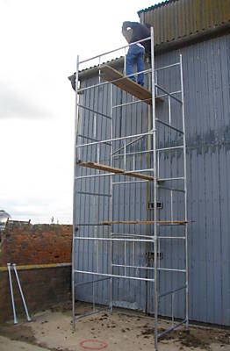
Which bits are you missing?
  NOT EN1004
  H Frame or Domestic steel tower
  Do not have proper platforms
  Do not have built in access
  Not supplied with stabilisers
  Have guardrail dimensions that would not prevent a fall
Notes:
This was actually the photograph from an advert from a company selling this type of tower

Slide 6
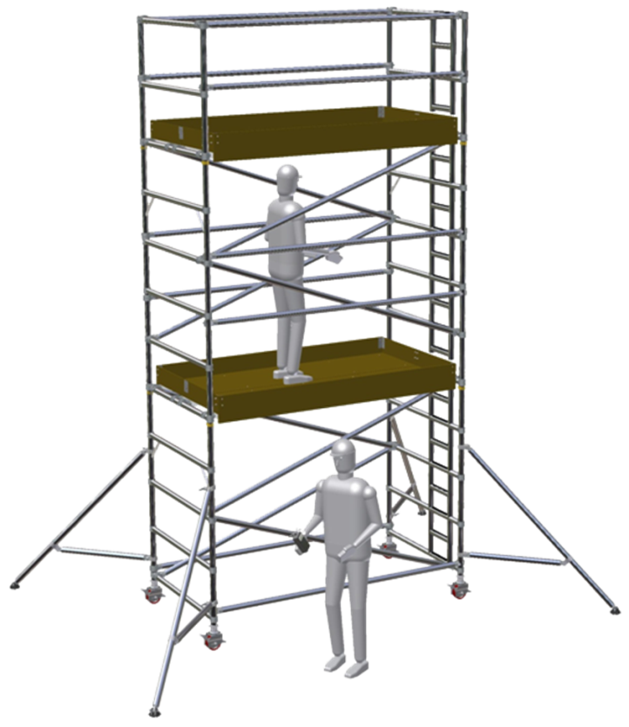
EN1004 Mobile Access Tower
Supplied with guardrails with dimensions to prevent a fall
Trapdoor platforms to permit safe access and prevent falls at 2m intervals
Supplied with toe boards to prevent the fall of materials
Supplied with purpose built access ladders or stairs inside the tower
Supplied with correct number of secure platforms
Supplied with correct number and size of stabilisers
Instructions comply with standard BS EN1298
Safe method of assembly and dismantling
Notes:
WHAT MAKES A GOOD TOWER

Slide 7
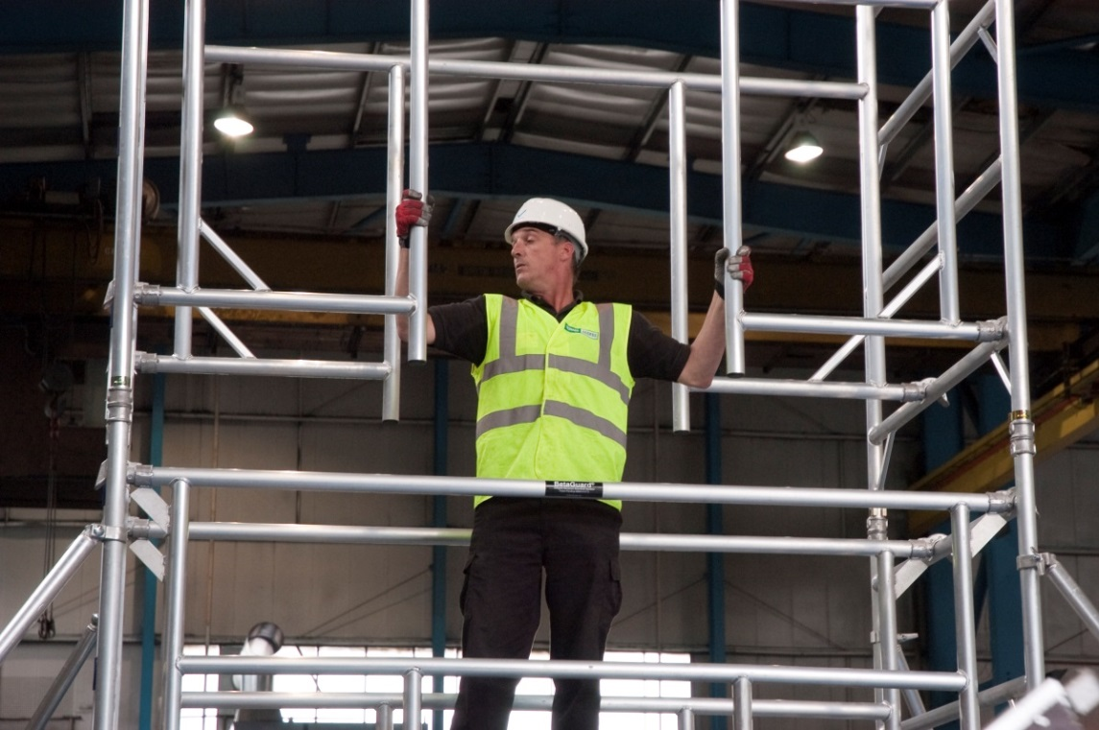
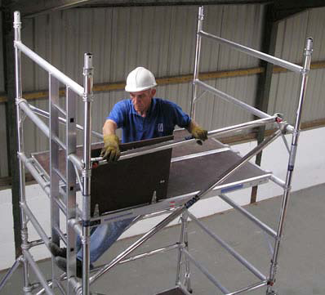
SAFE BUILD
3T – Through The Trap
AGR – Advance Guard Rail
Notes:
Assembly Methods
Two recognized ways to build, alter and dismantle mobile access tower
The first is 3T, or Through The Trap method of assembly allows the operative to position himself seated through the trapdoor of the platform and then to position horizontal braces ahead of himself to form a guardrail, before standing on the platform, thus providing collective fall prevention on any platform before anyone stands on the platform.
With 3T method you are never standing on an unprotected platform.
Dismantling using the 3T method requires the same methods to be applied. Whilst it is necessary to unclip the hooks furthest away from the trapdoor before removal, guardrail braces must never be removed whilst standing on the platform, but can only be removed from the safe position within the trapdoor.
Extensive research carried out by the HSL, and verified by PASMA and the HSE, have proven that the 3T method and the position within the trapdoor means that the operator is protected during assembly and dismantling.
Second method is to use an AGR – an Advance Guardrail System
Special AGR frames form part of towers structure and provide the side protection – the guardrails - to the platform.
Guardrails for the platform above are installed from the safety of the already guard-railed platform below
Dismantling is the reverse, so you are never standing on unprotected platform

Slide 8
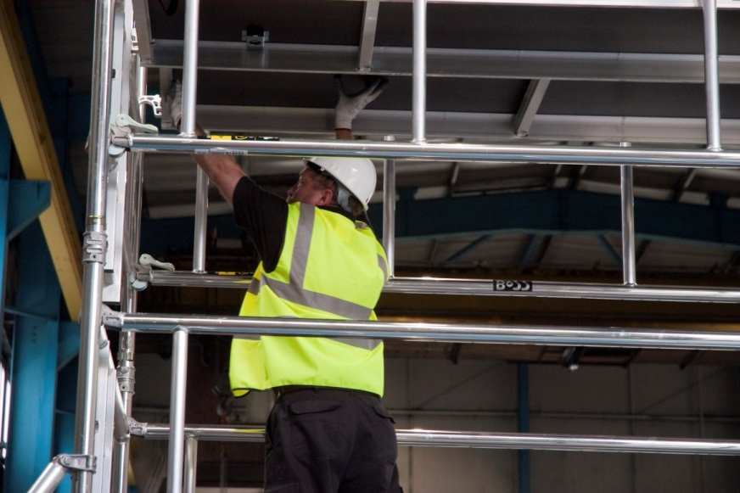
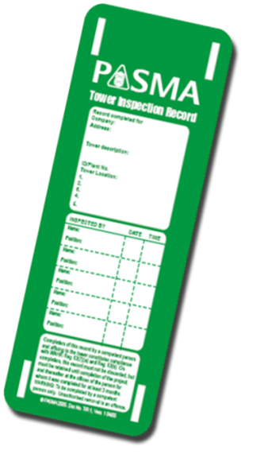
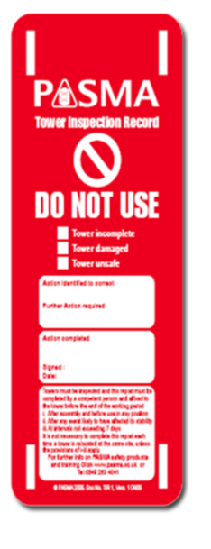
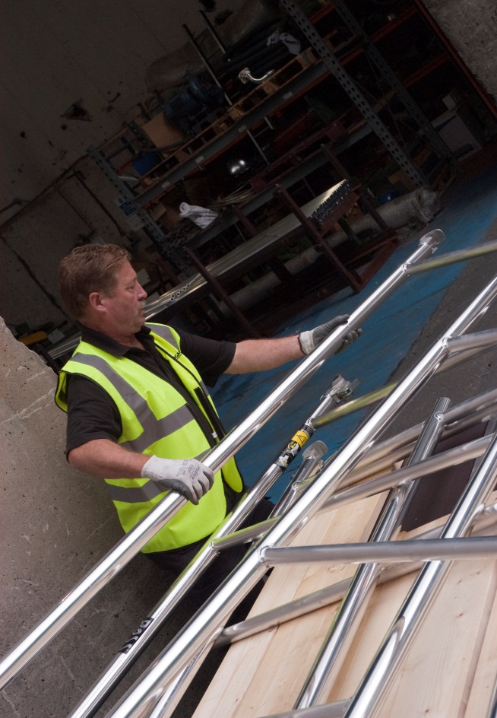
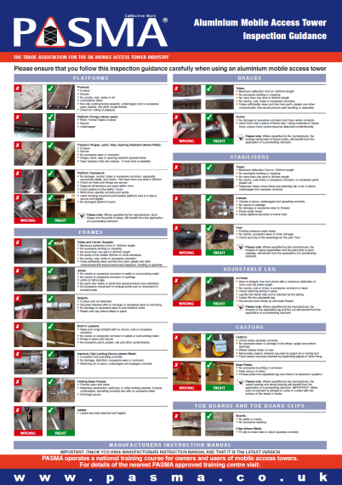
INSPECTION
  Recorded pre-use inspections following assembly of the tower:
Inspect after assembly, before use
At least every 7 days it remains in use
After any event that may have caused the tower to be unsafe
Routine recorded inspections on the components of the tower
Notes:
There are 2 main types of inspection that should be carried out on mobile towers
Recorded pre-use inspections following assembly of the tower
Routine recorded inspections on the components of the tower
FREQUENCY GOVERNED BY APPLICATION AND CONDITIONS OF USE AND STORAGE AND EVENTS THAT MAY ARISE
These inspections are a requirement of the Work at Height Regulations.
If you hire a tower the hire company is responsible for the routine detailed inspections unless you hire it for an extended period during in which the tower should be given a detailed inspection in which case you may need to take on that responsibility.

Slide 9
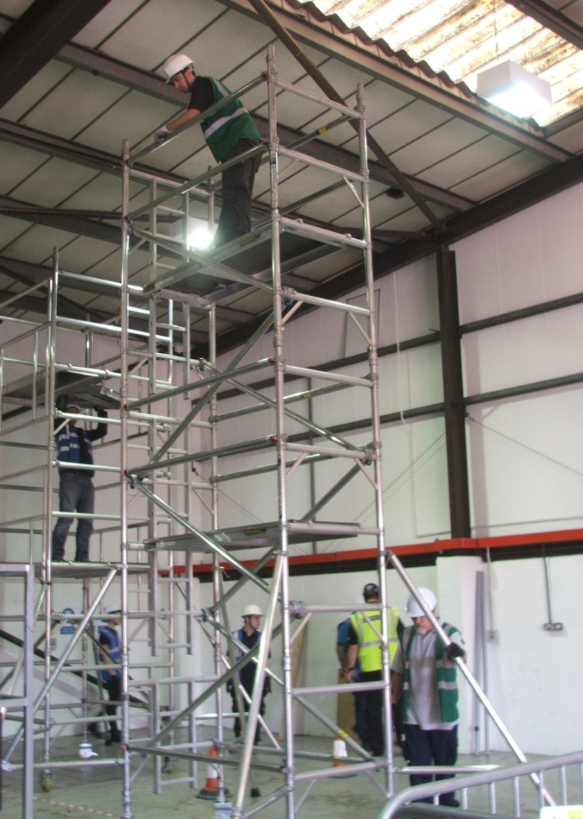

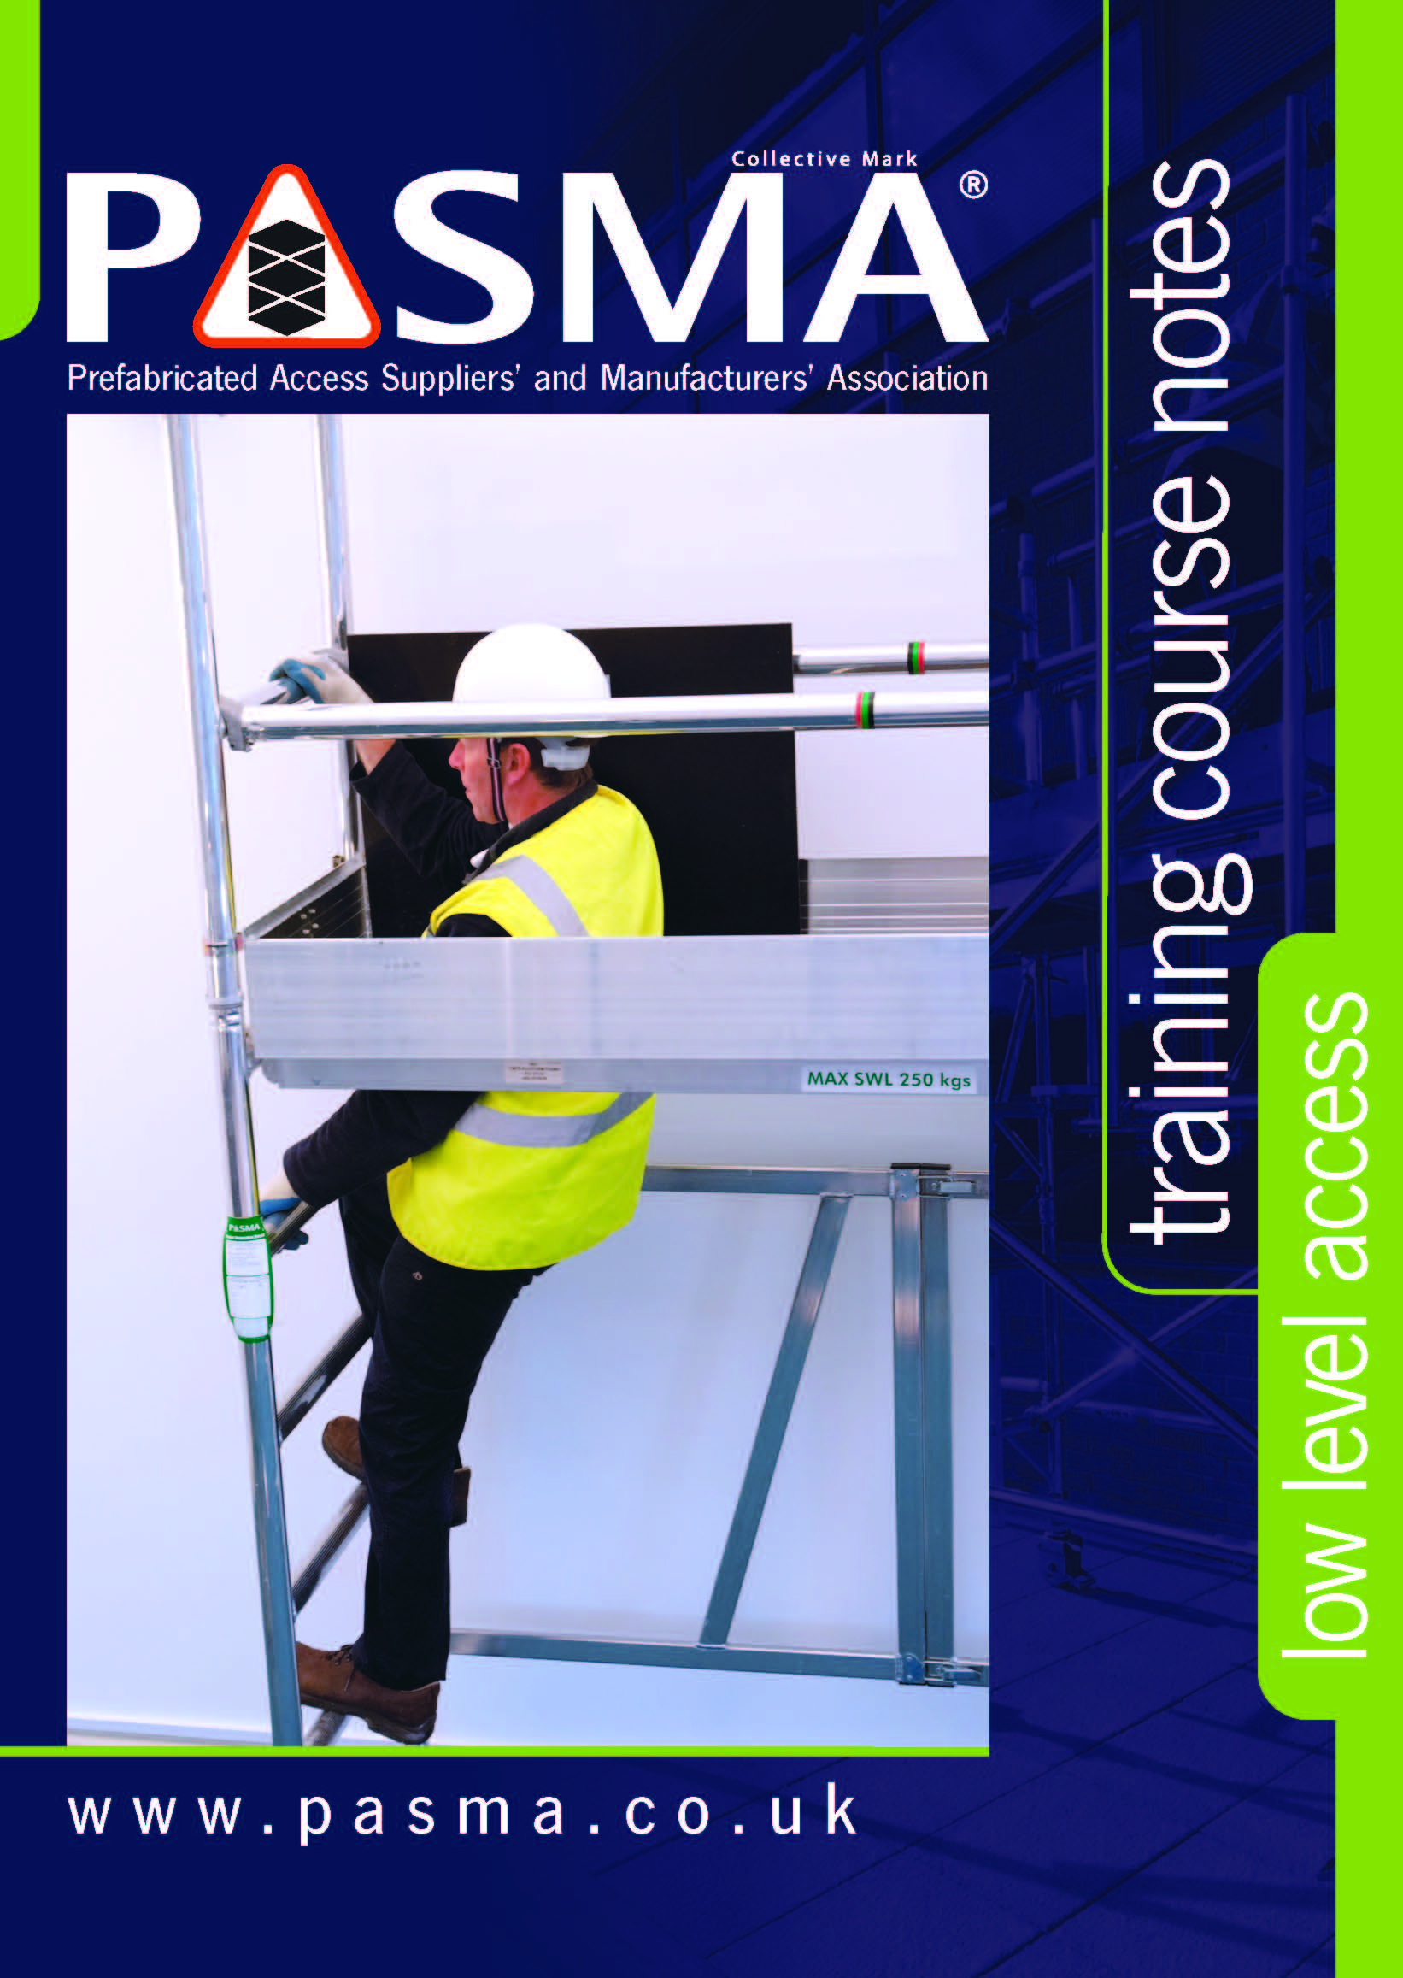
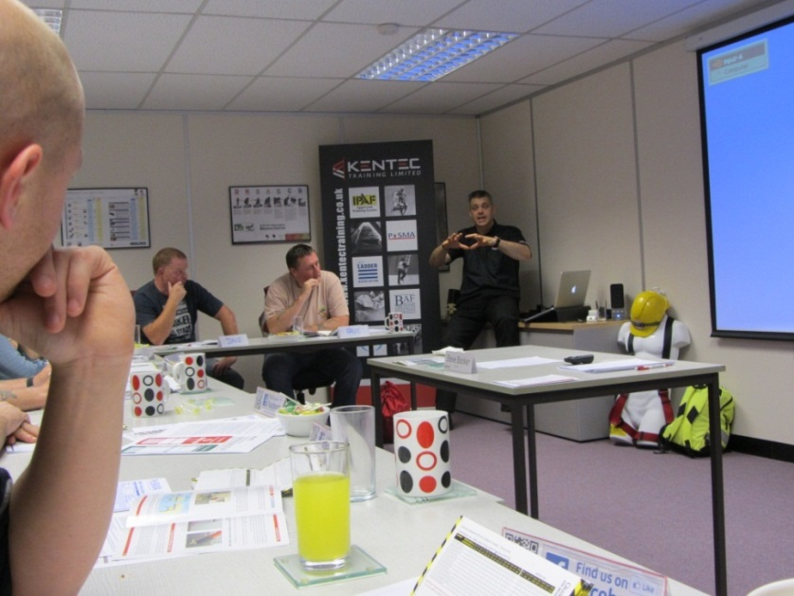
COMPETENCY
Notes:
Advisory Committee for Work at Height Training
“Person with sufficient professional or technical training and knowledge, actual experience and authority to enable them to;
Carry out their assigned duties at the level of responsibility allocated to them
Recognise potential hazards related to the work (or equipment) under consideration
Detect any defects, or omissions in that work (or equipment), recognise any implications for health and safety caused by those defects and omissions, and be able to specify a remedial action to mitigate those implications”.
PASMA training provides competence to build a tower, use a tower, move a tower, and dismantle a tower.
Competence to carry out inspections.
And competence to supervise work using mobile access towers.
As with all work at height the persons involved in the use of mobile access tower need to be competent.
PASMA provides training and verifies competence in the use of mobile access towers through its network of over 400 training center's in the UK.
Delegates receive both theoretical and practical training before being assessed to determine their competency.
Remember - You need to make sure that not only the person building the tower is competent but also the persons specifying, supervising and using the tower are appropriately trained to the required level.
Training schemes for scaffolders such as the Construction Industry Scaffolders Record Scheme (CISRS) are for tube and fitting scaffolding and certain manufacturers system scaffold. They do not address the specific knowledge required for mobile access towers,

Slide 10
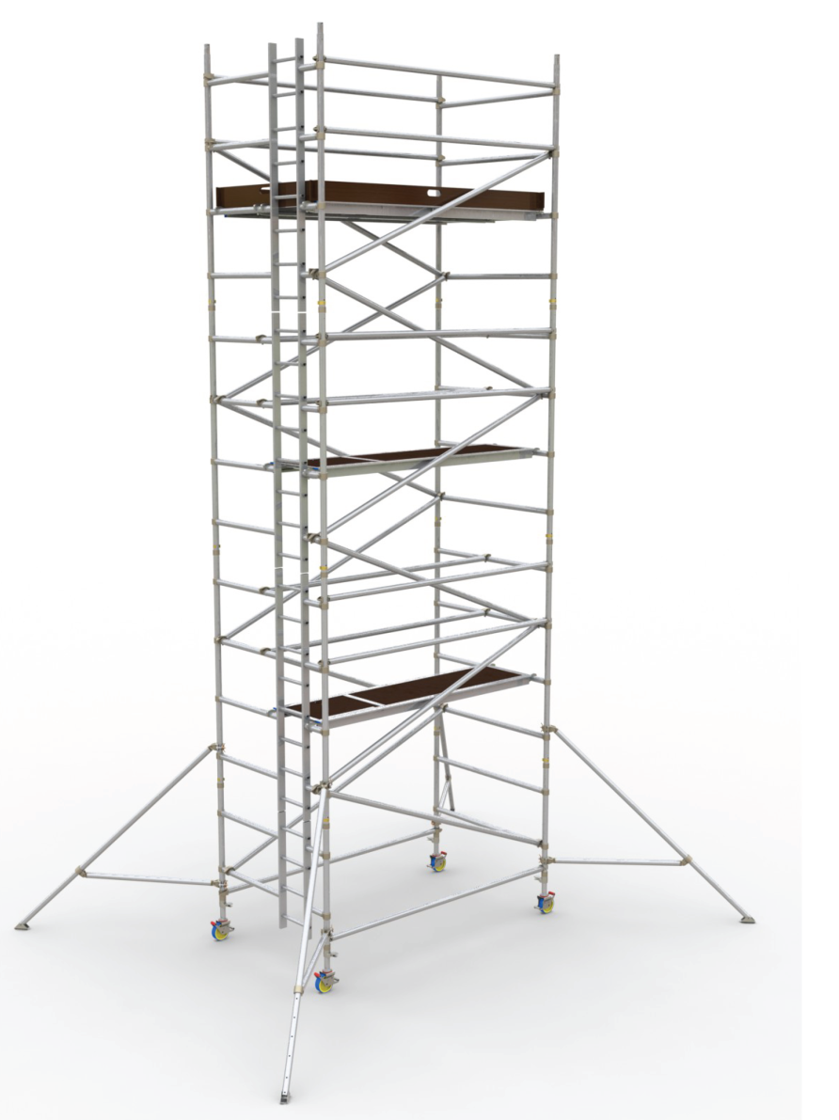
TOWER CHECKLIST
Instruction manual available
Guardrail height and gaps correct
Toe boards in place
Platforms secure on horizontals and wind-locks engaged
Platform trapdoors over access and opening towards outside of tower
End frame interlock clips engaged
Braces in correct position and hooks locked on
Smallest frame at the base of tower
Stabilisers correctly positioned

Slide 11
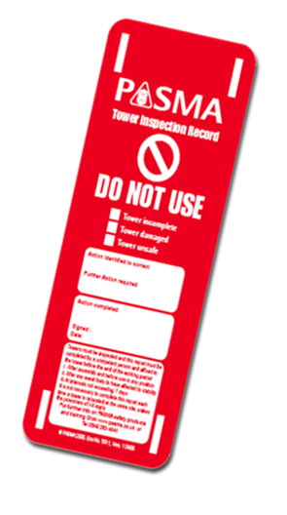
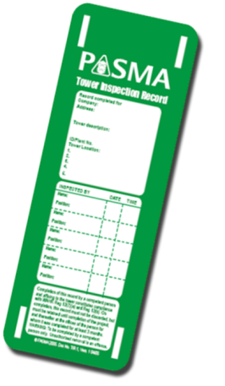
TOWER CHECKLIST
Ballast (if used) of correct type, correctly positioned and secure
If tied in, ties are adequate
Tower is vertical and level
Adjustable legs not over-extended
Brakes applied, wheels in contact with ground
Base plates (if used) in contact with ground
Ground conditions are appropriate
Weather conditions – wind speed
Inspection record completed

Slide 12
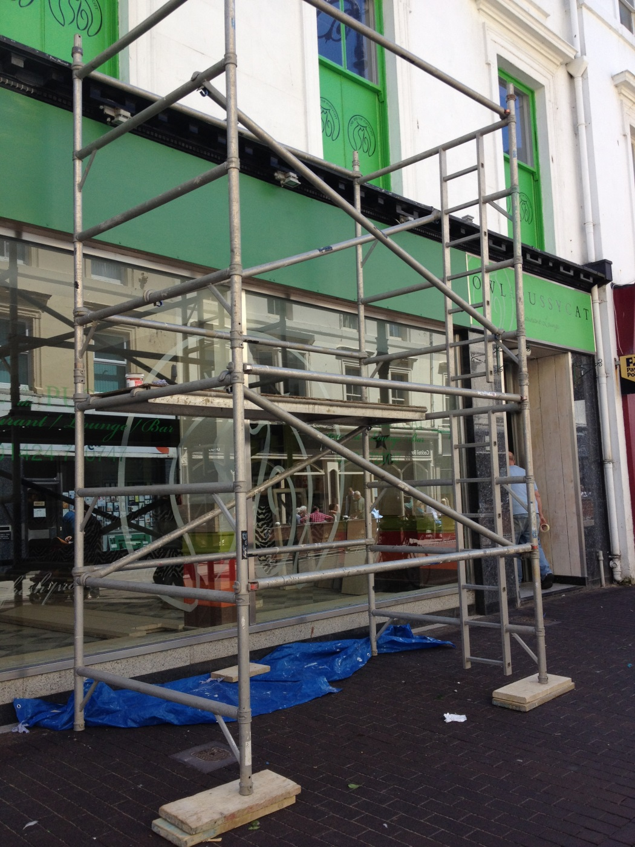
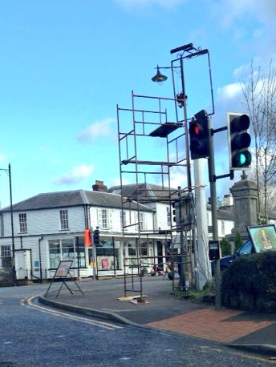

Slide 13
Which bits are you missing?
Select the right equipment for the job
Ensure it is built, used and dismantled safely by a competent person
Ensure it is inspected by a competent person
Don’t use a Tower that is lacking safety critical components
Notes:
Summary of key points

Slide 14


DISCUSSION & QUESTIONS

Slide 15
Working at height with towers: which bits are you missing?
Thank you for your Attention
Notes:
Welcome
Introductions
Thanks to host
This is your day

